Slide 1
State Transition Diagram Evaluation
Objective: Assess state diagrams generated from natural language requirements.

Slide 2
Evaluation Criteria
We evaluate each diagram against 5 criteria using a 1–5 scale.
Criterion | What we check in a State Diagram
Completeness | Are all required states, transitions, events, guards, initial/final states present?
Correctness | Does the state behavior logically match the requirement? (No contradictions)
Understandability | Is the diagram clear, readable, and not unnecessarily complex/redundant?
Terminological Alignment | Do state names and transition labels use the exact terms from the requirement?

Slide 3
The 1–5 Rating Scale
Score | Meaning | When to use
1 | Not fulfilled at all | Missing major elements, logically wrong, or incomprehensible
2 | Fulfilled to a minimal extent | Very few elements present, but mostly incorrect
3 | Partially fulfilled | Some parts OK, but clear gaps or errors
4 | Mainly fulfilled | Most requirements met, minor issues only
5 | Completely fulfilled | All requirements met perfectly, no issues
Important: For each score below 5, please write a short textual justification explaining the problem(s) observed. This will be used for qualitative issue analysis.

Slide 4
Example 1
First Person Shooter Fps Games — Polished Requirement Specification
Overview
A troll in a game normally stays calm and does nothing when there is no threat around. As soon as it notices an opponent, its reaction depends on how strong the opponent appears. If the opponent looks weak enough to defeat, the troll becomes aggressive and starts attacking.
Operational Context
Primary actors are not explicitly stated in the source text.
Functional Requirements
1. The system shall keep the troll in a calm state with no actions if there is no detected threat.
2. The system shall determine the troll's reaction based on the perceived strength of the detected opponent.
3. The system shall make the troll aggressive and start an attack if the opponent appears weak enough to defeat.
4. The system shall continue the troll's fight while it can see the opponent.
5. The system shall calm the troll and return it to a normal state if it loses sight of the opponent.
6. The system shall make the troll scared and panic if the opponent appears too strong.
7. The system shall calm the troll and return it to a normal state if it gets away from or loses sight of a stronger opponent.
8. The system shall remove the troll from the game if it takes a fatal hit and its health reaches zero.
You will be provided with the requirements in this format.

Slide 5
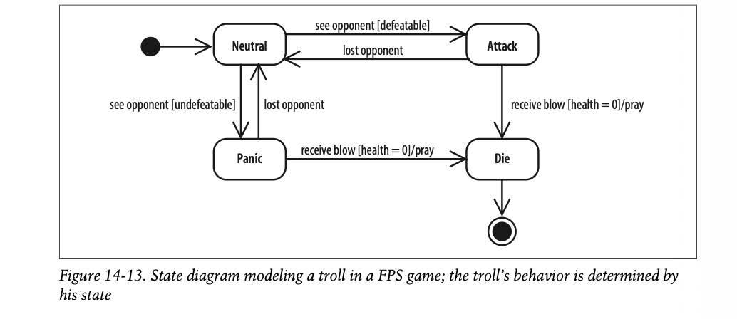
Example 1
And the diagram in this format.
Note: This is an example of a correct diagramming format.

Slide 6
Example 2
Product Recommendation - Polished Requirement Specification
Overview
A user enters the platform by registering or signing in. Once access is granted, the user searches for a product, and the system displays the matching results. After viewing the search results, the user may choose to apply filters to narrow down the options.
Operational Context
Primary actors include user.
Functional Requirements
1. The system shall allow users to register or sign in to access the platform.
2. The system shall enable users to search for products after they have registered or logged in.
3. The system shall display matching product results based on the user's search query.
4. The system shall allow users to apply filters to refine their search results.
5. The system shall update the displayed product results based on the applied filters.
6. The system shall allow users to select a product from search or filtered results.
7. The system shall redirect the user to the official website of the selected product upon selection.

Slide 7
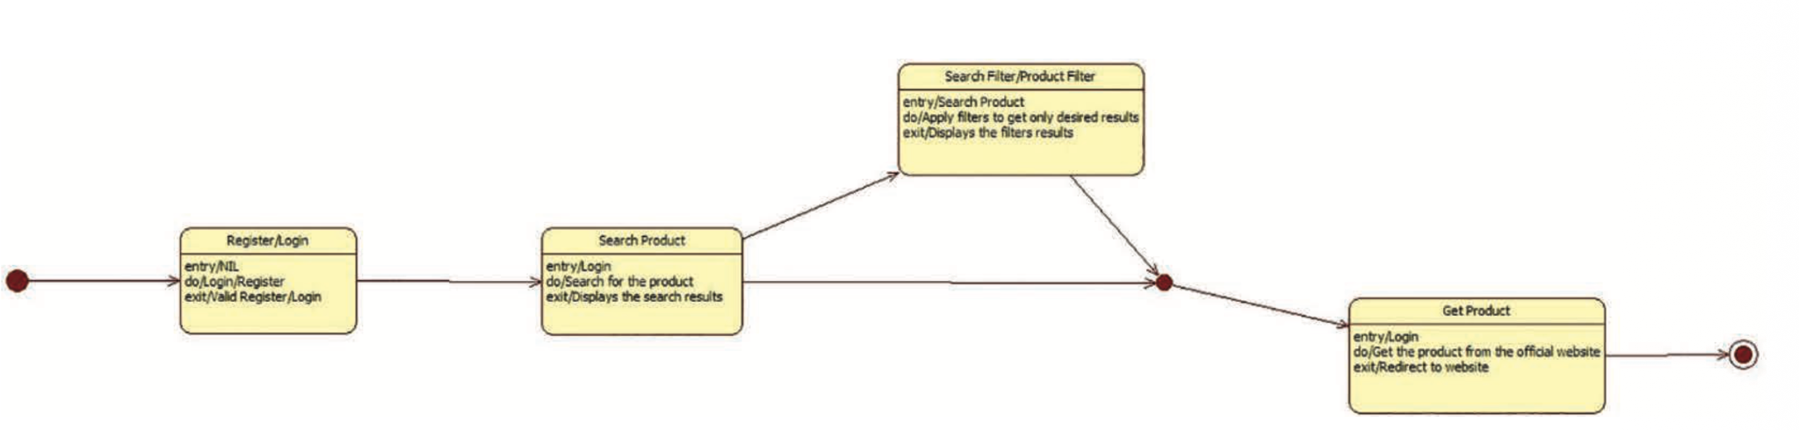
Example 2
Note that this is more of a software solution, which is better interpreted using other behavioral models (sequence diagram), but this is still correct.
And the diagram in this format.
Note: This is ALSO an example of a correct diagramming format.

Slide 8
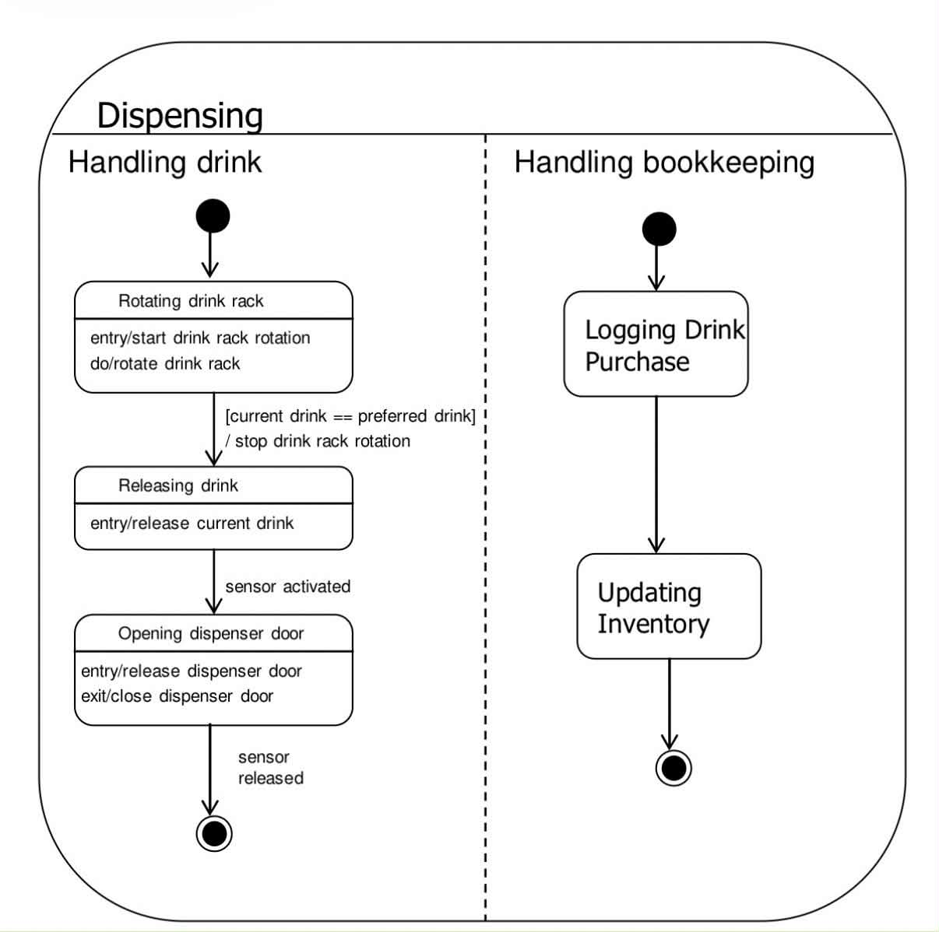
Composite states
This is an example of a composite state where multiple states can be in that composite state. The dotted line indicates AND function as in both can happen simultaneously. The machine can dispense the drink and update the bookkeeping at the same time.

Slide 9
Summary – What We Need From You
Your Task | Format
1. Review each diagram against the 4 criteria | 1–5 score per criterion
2. Write a short justification for any score <5 | Free text (1–2 sentences)
3. Return completed form for each diagram | https://forms.gle/qjBy5NxoFtYCU9Tw5
Time per diagram: ~5–10 minutes
Questions? Ask before starting.
Thank you!

